Slide 1
MICROPROCESSOR & MICRCONTROLLER
II MSc PHYSICS
Dr R THILAK KUMAR

Slide 2
8085 ARCHITECTURE
The process of data manipulation and communication is determined by the logic design of the microprocessor is called the architecture. Fig. shows the internal architecture/ functional block diagram of the 8085. It includes the following units.
Register array
ALU and associated circuitry
Instruction register and decoder
Timing and control unit
Interrupts and Serial I/O

Slide 3
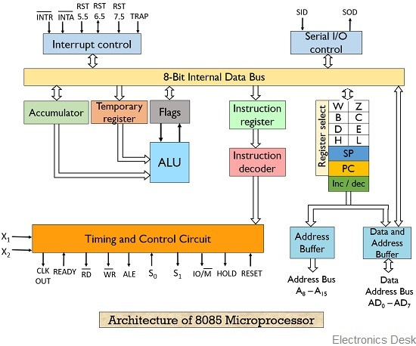

Slide 4
i) Register array
The 8085 has six general purpose registers named as B,C,D,E,H and L.
Each register can hold an 8 bit-data.
The six registers can also be combined as register pairs BC,DE and HL.
A register pair now, can hold a 16-bit data or a 16-bit address.
When used as a 8-bit register, each register can store a data ranging from 00_{H} to FF_{H}.
When used as a 16-bit register, each register can store a data ranging from 0000_{H} to FFFF_{H}.
These registers are used for temporary storage of data.

Slide 5
Program counter (PC)
It is a 16-bit register.
The PC holds the 16-bit address of the memory from which the next byte is to be fetched.
When a byte is being fetched, the PC is automatically incremented by on to point to the next memory location.
Stack pointer (SP)
The stack pointer is also a 16-bit register.
It holds the address of the stack top.
A stack is a group of memory locations in RAM (random access memory) defined by the programmer.
It is used to save the contents of the registers and during interrupts.

Slide 6
Address latch-Incrementer/Decrementer
The address latch is useful in selecting the address of the memory to be sent out from program counter or stack pointer or any of the register pairs.
An incrementer and decrementer allows the contents of any of the 16-bit regiseters which hold the address to be incremented or decremented.
Two additional registers W and Z are included in the register array. These registers are used to hold 8-bit data during the execution of some instructions.

Slide 7
ii) ALU and associated circuitry
The Arithmetic Logic Unit (ALU) of 8085 performs arithmetic and logic operations on two 8-bit data.
It includes the accumulator, temporary register and five flags.
The temporary register is used to hold data during an arithmetic/logic operation. The result is stored in the accumulator and the flags (flip-flops) are set or reset according to the result of the operation.

Slide 8
Accumulator
The accumulator is a special 8-bit register.
This register is used to store 8-bit data as well as to perform arithmetic and logic operations.
This register is identified as A.
Temporary register
The temporary register simply receives one of the operands from the internal data bus and sends it to the ALU.

Slide 9
Flags (flip-flops)
There are five flip-flops that are set or reset after each arithmetic or logic operation. They are called as flag registers.
Carry flag (CY)
The carry flag is set to 1 if a carry is produced by an arithmetic or logic operation and reset to 0 for no carry.
For example, if an instruction adds two numbers and if the result is less than FF_{H}, then no carry is produced and the CY flag is reset to 0.
On the other hand, if the result exceeds FF_{H}, then a carry is produced and CY flag is set to 1.
It serves as a borrow flag for subtraction.

Slide 10
Zero-flag (z)
The zero flag is set to 1 if the result of an arithmetic or a logic operation is zero and reset to 0 if the result is non-zero.
For example, if A register and B register have the same data, and if we perform SUB B operation, the result is zero.
Now the zero flag Z is set to 1.
When the data in A and B registers are not equal, after SUB B operation, the result in the accumulator is not zero and hence the zero flag is reset to 0.
Parity flag (P)
After an arithmetic or logical operation, if the results have an even number of 1s, the flag is set to 1.
If it has an odd number of 1s, the flag is reset to 0.
For example the data byte 0000 0011 has even parity.
It is useful for error checking during serial communication.

Slide 11
Sign flag (S)
The sign flag is used when working with 8-bit signed (positive and negative) numbers.
The most significant bit (MSB), D₇ is used as a sign bit.
If D₇ bit is o, then the number is taken as a positive number and if D₇ bit is 1, the number is taken as a negative number in 2’s complement form.
In 8085, the sign flag is set to 1 if the MSB D₇ is 1 and the sign flag is reset to 0 if the MSB D₇ is 0.

Slide 12
Auxiliary carry flag (AC)
The auxiliary flag is set to 1, when a carry is generated at digit D₃ position and passed on to digit D₄.
This flag is used only internally for BCD (binary coded decimal) operations and not available for the programmer.
That is the programmer cannot used the auxiliary carry flag condition to change the sequence of the program.
The relative bit position of different flags in an 8-bit flag register is shown in below.

Slide 13
Among the five flags, Z flag and CY flag will be widely used to learn assembly language programs. The sign flag S muse be used only with signed numbers

Slide 14
S = sign flag; If S=1, if MSB of ALU result =1
Z= zero flag; Z=1 if ALU result = 00H
P= parity flag; P=1 if ALU result is even parity
CY= carry flag; CY=1 if carry or borrow is occurred during addition/subtraction
AC = auxiliary carry; carry from lower nibble to upper
borrow from upper nibble to lower

Slide 15
Status of the flags
Example
BC_{H} + DE_{H}
B C 1011 1100
DE 1101 1110
9A 1001 1010
S = 1
Z =0
P =1
CY=1
AC =1
1
1
1
1
1

Slide 16
iii) Instruction register and decoder
The instruction register and the decoder are part of the ALU. When an instruction fetched from memory, it is loaded in the instruction register.
The decoder decodes the instruction and establishes the sequence of events to follow.
The instruction register is not programmable and cannot be accessed through any instruction.

Slide 17
iv) Timing and control unit
The instruction is decoded and necessary information is passed on to the timing and control unit of 8085.
Depending on the instruction, the timing and control unit generates the required timing and control signals for executing the instructions.
v) Interrupts serial I/O
The 8085 microprocessor can be interrupted by any one of five interrupt input pins namely, INTR, TRAP, RST 7.5, RST 6.5 and RST 5.5.
Two pins SID and SOD are used for the serial communication.

